Slide 1
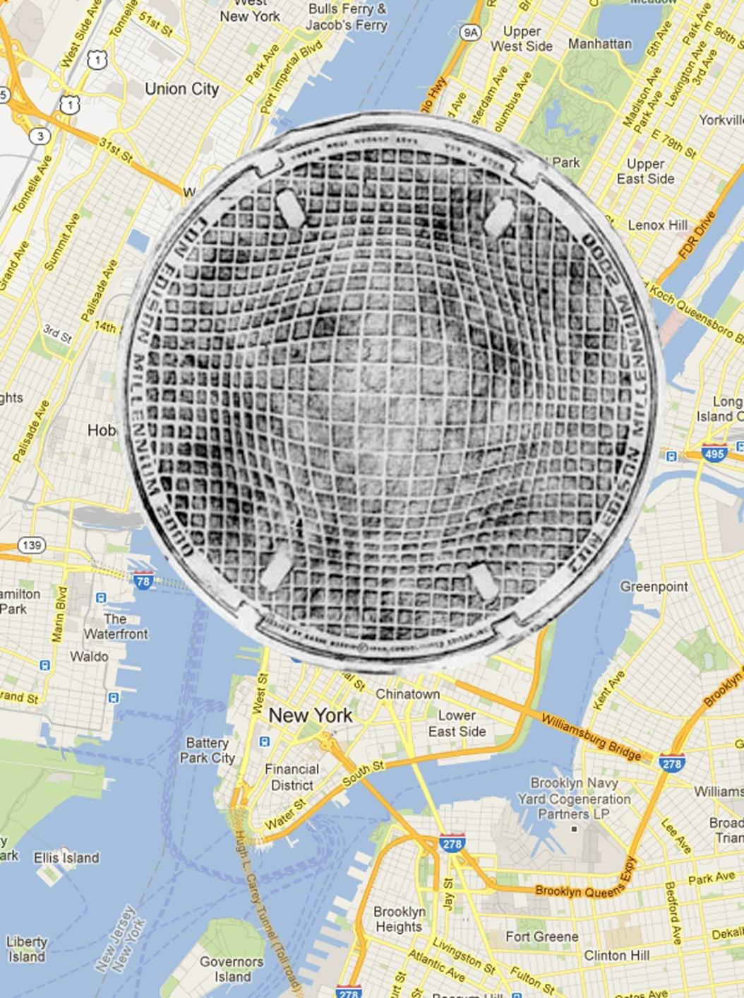
Gisla Burkhardt
Inspiration
Underfoot in
New York
Graphically Enhanced Rubbings
OF Coal Chute, Manhole
and Handhole Covers

Slide 2
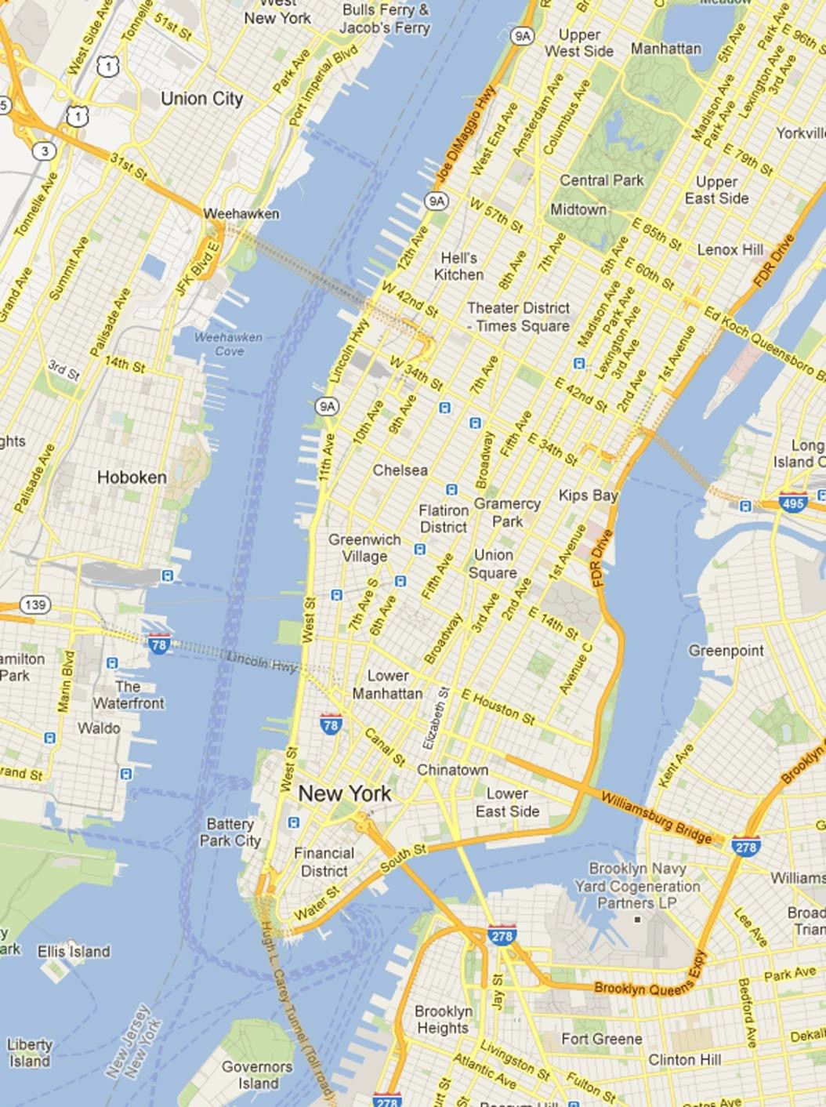
2
UNDERFOOT
IN NEW YORK
Gisla Burkhardt
A City in Hiding Beneath the City of New York
Walking the City of New York one frequently steps on patches of cast iron with patterns resembling foot prints or horse shoe prints of the past. Those steam-belching vents, manhole, handhole and coal chute covers are the only visible reminders of an underground city indispensable for New York’s infrastructure. As an add-on to their function as gateway to the City’s infrastructure, manhole, coal chute, and handhole covers display beauty, symbolism and wide-open design possibilities – they are footprints of history.
Their beauty often goes unnoticed and is slowly disappearing: some very old and decorative ones have been stolen, some simply yield to modern development and others may have been destroyed by 9/11. Unfortunately, thieves steal the cast-iron manhole covers, break them into pieces and then sell the pieces to scrap-metal dealers for whatever they can get, and the dealers don’t ask too many questions – even though the source of the bounty is quite obvious. Some of the covers find their way into »sanctuaries« provided by collectors.
If you walk the streets without noticing the covers, you’ll miss a lot of delicate cast-iron artwork and, just maybe, a hint of the history of New York City. Electrical wiring, water mains, sewers, traffic and train tunnels all pulse and vibrate under your feet as you walk the five boroughs. There are at least 600,000 of those covers in the City.
Sidewalks provide safe space for people to walk the City and an opportunity to view hidden beauty. Looking down can reveal unexpected attractions!

Slide 3
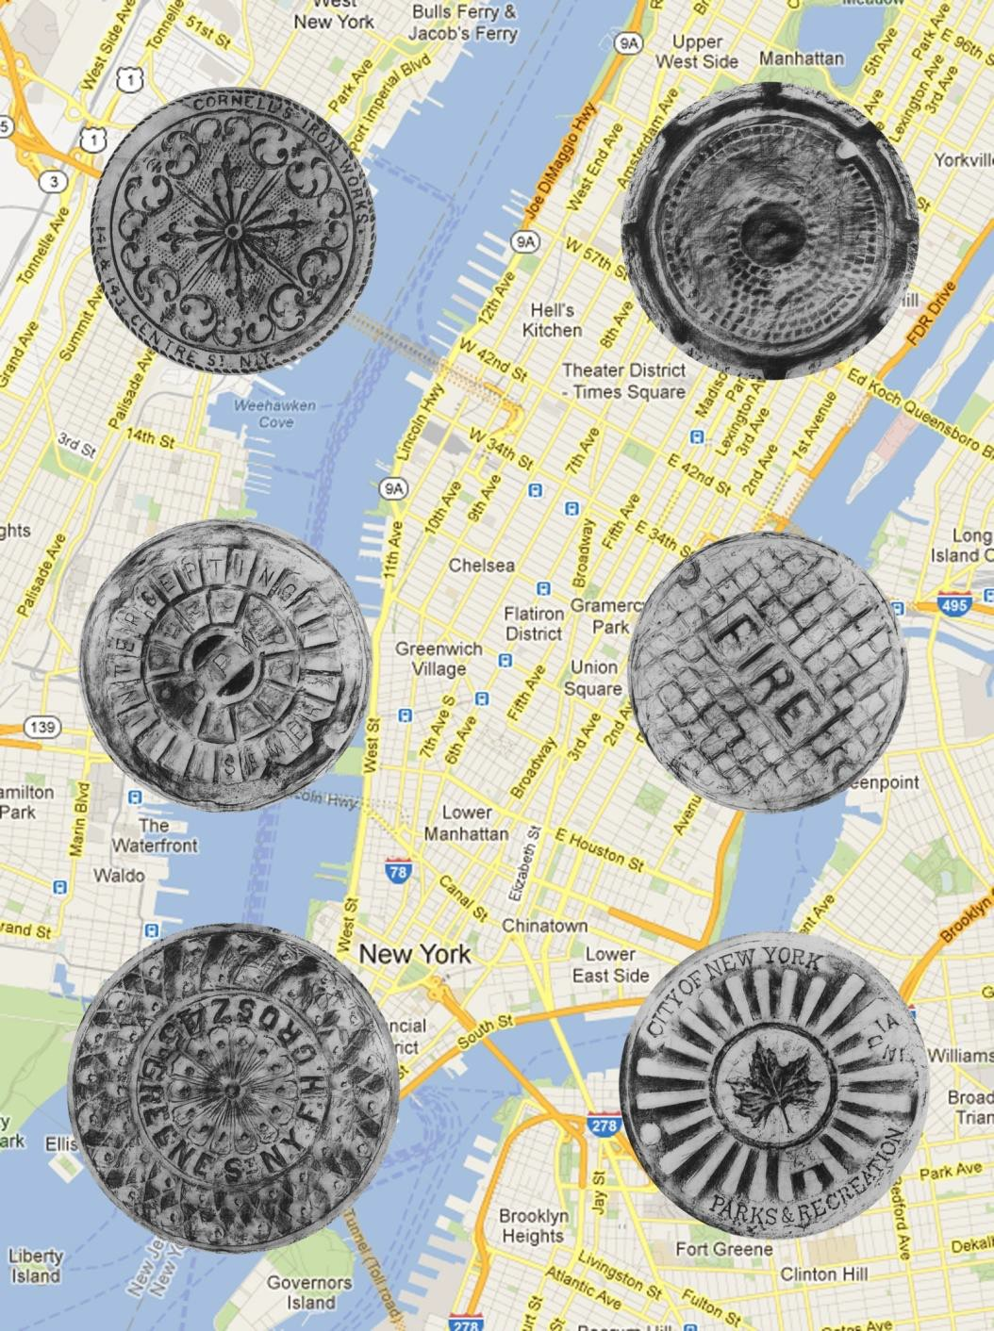
UNDERFOOT
IN NEW YORK
Gisla Burkhardt
Coal chute covers were the first iron lids which were used, beginning about 1840, onward to cover holes in the streets to slide coal into the basements of the adjacent houses. Later, step by step manhole covers started to become part of the streetscape to access cables beneath the streets, equipment for repairing wires, most importantly water (against fire) and sewage as well as gas for lighting the streets. The small ones (water supply) are called handhole covers.
Around 1880, electric light and electrical street car lines started their conquest of the City. To avoid the destructing powers of the elements, these, and other infrastructure utilities for the growing city were installed underground after the blizzard of 1885 and had to share their space with the underground lines for gas, telephone, telegraph, water, power, and sanitary sewer, cables and equipment for traffic signals, as well as fire hydrants. Along with these standard utility connections various companies had under-ground facilities (for example pneumatic tubes).
In the 19th century, most of the covers were designed by the foundry workers on their own. Artisans made the cover design out of wood, the cover would then be cast in a sand mold. These days, some artists are playing with the surface, coming up with eye- catching designs. Karim Rashid, a well-known participant of “Documenta”, won the competition started by Con Edison for the millennium cover.
Many foundries were start-ups when the first coal chute covers were cast. Later there were about 800 of them in Downtown (SoHo) and 120 in Brooklyn. Naturally not all of them producing those covers and if they did, they most likely made other artefacts as well. Today new covers are produced in India – often in dire circumstances without observing any ecological necessities and mostly without regard to style and art.

Slide 4
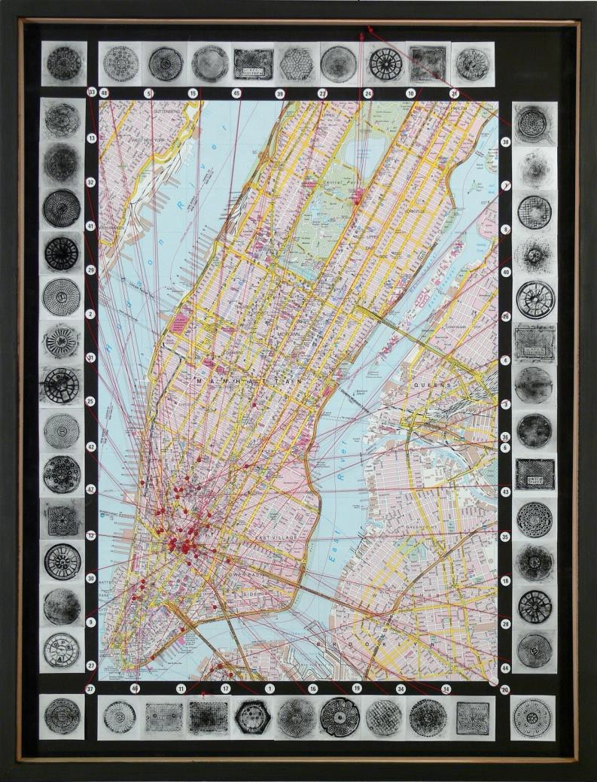
4
UNDERFOOT
IN NEW YORK
Gisla Burkhardt
Two centuries later, many of the covers are still in use. Their design might be early 19th century, but the iron lids are durable and still reveal their art and beauty. Their age can be determined by the aesthetic style of the time. But the first coal chute covers I found in Charlton Street / SoHo having decor elements from a period before they were cast carrying floral motifs like ornamental decors of rococo architecture. Also, letters used in inscriptions help identify the age of the design: older ones used serifs. Victorian motifs, Art Nouveau and Art Deco resemble architectural components in the aesthetic style of their time.
Patterns of the covers often match the utilities underground. Some covers have identifying abbreviations, such as WSNY for Water Supply New York – or DPW for Department of Public Works. Some (mostly the older ones) are inscribed with the name of the foundry, sometimes with the date of design or manufacture. Many treads with simplified diamonds, stars, honeycombs, fishplates, herring bones, waffles, snowflakes apply to specific purposes and functions. Cartwheels are often castings for the Department of Public Works, and since New York has a large port it is not surprising that one can also find waves and ship steering-wheels and other maritime elements.
For electricity (since ca. 1880 Con Edison), there are often abstract electric plugs on the covers. Traffic systems have mostly patterns with radiating chains. The iron covers with stars and starbursts (designed in the last years of 19th century) are used repeatedly to represent foundries and private companies. There are many covers designed with hexagons & honeycombs or square dots in circular lines for sewers, public works, and sanitary systems.

Slide 5
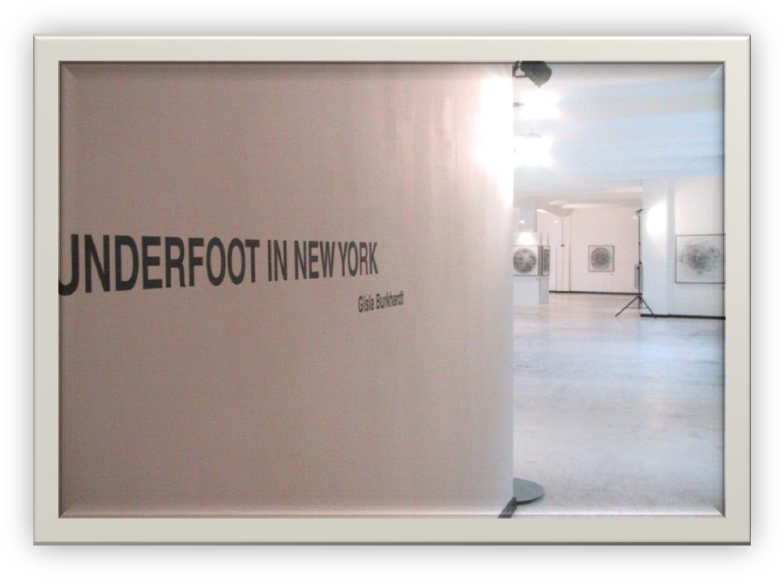
5
UNDERFOOT
IN NEW YORK
Gisla Burkhardt
New York’s »queen of the covers«, Diana Stuart, studied hardware catalogues of the 19th century and found herringbone patterns, snowflakes, tick-tack-toe grids, cart- wheels, pinwheels, diamonds, and bingo boards. Designers integrated the beauty and culture of what makes New York so special into these covers.
With the City growing, the industrial revolution demanded more and new utilities, which had to move underground and were in need of manhole covers. Thousands of covers were cast and installed laying further foundation for the creativity not to be missed Underfoot in New York.
December 2001 marked the first public exhibition of Gisla Burkhardt’s beautiful graphically enhanced rubbings of those covers Underfoot in New York which opened in Berlin!
Reading the New York Times, one learns that even nowadays thieves continue to steal the cast-iron manhole covers: it is a costly problem for Con Edison and others! Luckily there are collectors like Tom and Toni Cohill in Amityville, Long Island, who work for the conservation of this
Preview of a sample of UNDERFOOT IN NEW YORK displayed in Berlin at GSG in December 2001 in cooperation with International Design Center
HIDDEN ART on the STREETS of NEW YORK
Approximately 400 photos of manhole covers are presented in the 2003 documentary work of Diana Stuart who published
»DESIGNS UNDERFOOT – The Art of Manhole Covers in New York City«.

Slide 6
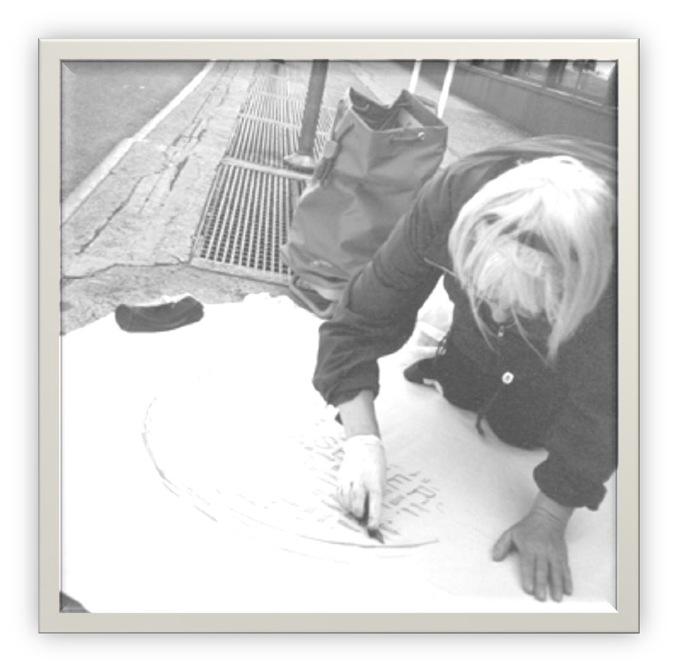
6
UNDERFOOT
IN NEW YORK
Gisla Burkhardt
My Brief History of the Project
Beginning in 1999, I was in New York numerous times offering my Berlin Studio in exchange for accommodation and a studio in this fabulous city. With the question of transport as well as art and cultural impact in mind, I searched for a »suitcase-project« and was fascinated by the iron covers of the gateways to the city beneath the City of New York.
Through July 2000, I produced 50 different rubbings of covers using graphite on cotton. Later, in the studio I upgraded them graphically with graphite. Initially this was purely an artist‘s project. After some research at the Public Library on 42nd Street and learning about the development of the City, its infrastructure and the history of the iron foundries, I decided to create as complete a documentation as possible.
Cultural Attaché Ludwig Linden at the German House in New York got me into contact with Peter Simmons and Claire Bell, then curator and director of the Museum of the City of New York who at the end of 2000 wrote to me a letter indicating that the museum considered holding an exhibition of my manhole cover art work. This brought my project to a new level – it now became my project for the City of New York. A heartfelt connection blossomed!
I was able to contact the CEO of Con Edison. Many of my rubbings are Con Edison manhole covers, including the Millennium Cover designed by Karim Rashid in 1999 and one designed by Lawrence Weiner. Con Edison was prepared to finance the exhibition. There was an exhibition slot in Autumn 2006 – but then the management of Con Edison changed and sponsorship was delayed indefinitely! After recovering from this blow, I‘m now revitalizing the project: out of 120 works of art and history 70 are framed and 50 selected and ready for New York … and ready to broaden the way pedestrians see beauty in the City forever …
Gisla Burkhardt working on Broadway in May 2000

Slide 7
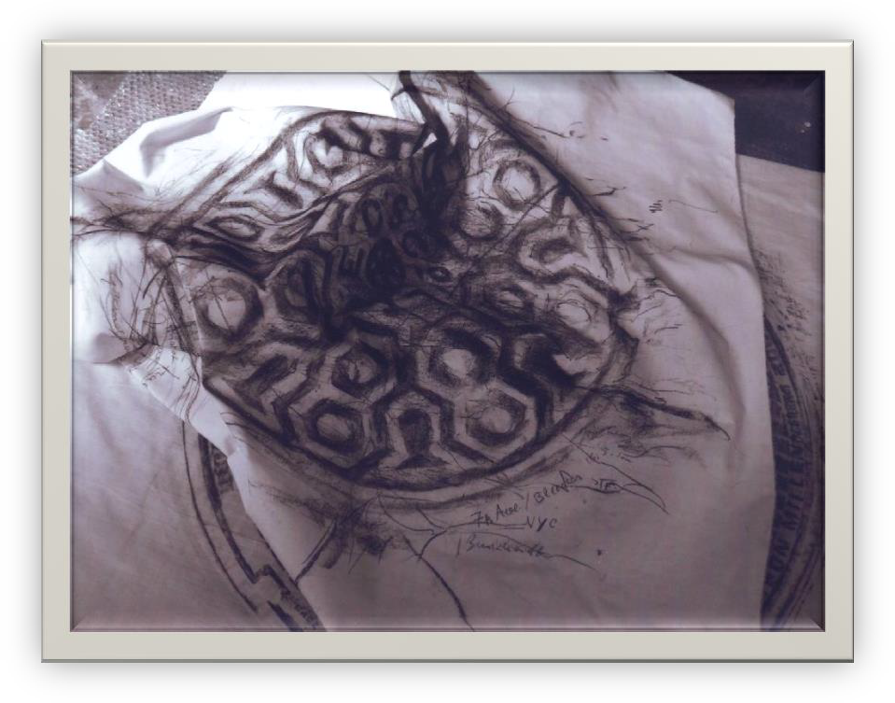
7
UNDERFOOT
IN NEW YORK
Gisla Burkhardt
More about the Project
The graphically enhanced rubbings of the coal chute, manhole and handhole covers were made on strong cotton which I bought on Broadway. The rubbings make details visible that would normally not be noticed by passersby. Those marks of time (wear and tear) have fascinated me and inspired me to create more than 120 different manhole cover rubbings in New York with the covers dated between 1830 and 2000. 70 of them are framed and catalogued with details as to their location and time of creation (where ever possible).
The size of the framed pieces are between 80 cm by 80 cm (approximately 32 inches) and 120 cm by 120 cm ( approximately 48 inches).
How it all began…
Visitors to New York normally walk the streets with their eyes looking up in the air to see the famous skyscrapers. I did the opposite – looking downward – and I found man- hole, coal chute, and handhole covers with diameters ranging from 20 cm (appr. 8 inches) to 120 cm (approx. 48 inches) all made in cast iron. I discovered them first in the former iron foundry district, Soho, and then couldn‘t stop looking for them.
They are relicts of history of the City as it grew, living art displaying its historical and economical development. Some covers display the name of the iron foundry or the name of the company using the chute below and denote the verve and character of the times. Their decorative elements not only help dating them but add to the innovative atmosphere that is New York.

Slide 8
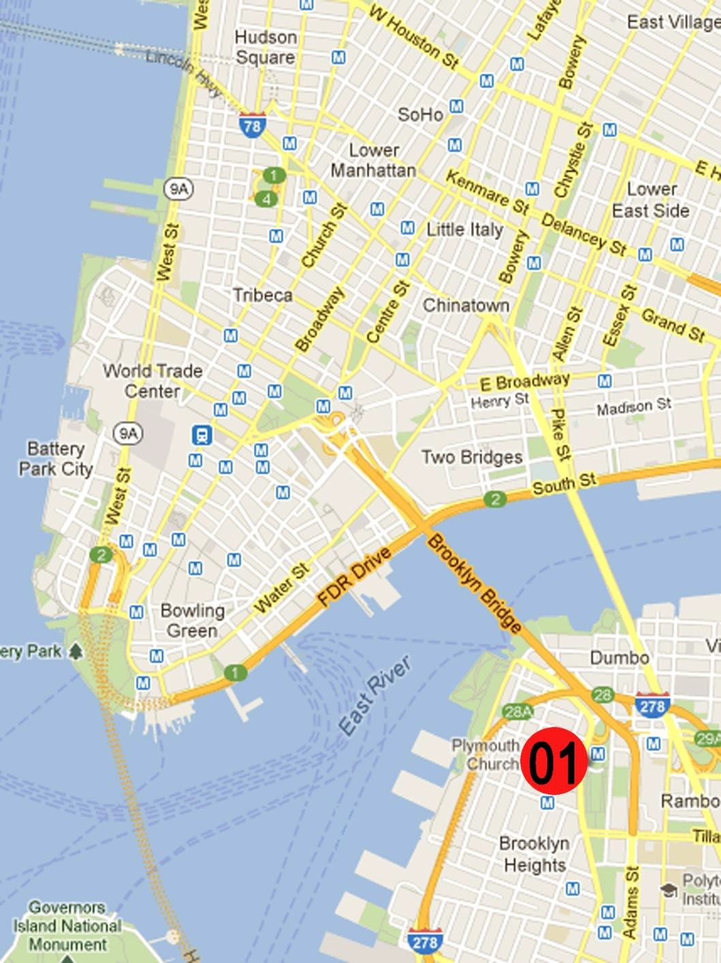
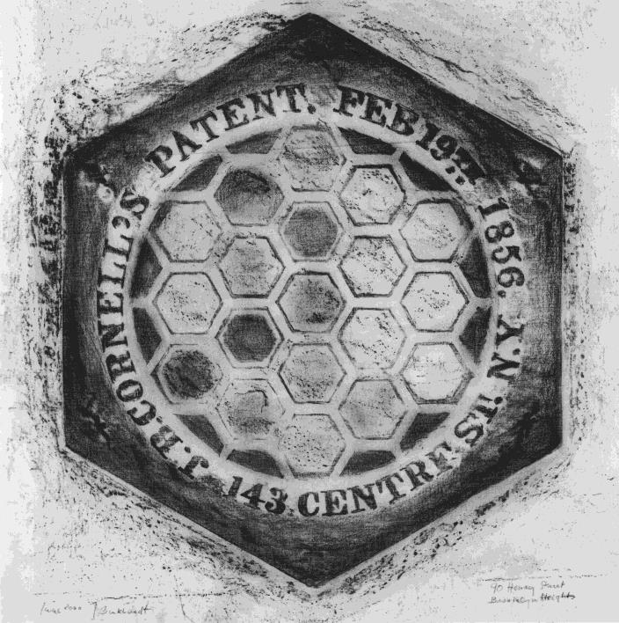
8
UNDERFOOT
IN NEW YORK
Gisla Burkhardt
90 Henry Street, Brooklyn Heights
19th February 1856; J.B. Cornell‘s Patent Rubbing made June 2000
While shopping in a small drugstore in Brooklyn, by accident I found an unusual cover hidden under crates of fruit within the entrance of the shop. There are many covers with 8 corners, but this was the first six-sided one I found. The shopkeeper was helpful and moved the crates so that I was able to access the cover for the rubbing. He was visibly proud when he learned that this was an exceptional discovery.
Later, I learned that even Diana Stuart, the queen of manhole covers in New York, had not known of six-sided covers that old. She thinks this one is today the only one that is still in existence. Also, she argues, it is one of the last ones produced by J.B. Cornells in their foundry at 143 Centre Street. Since Cornell’s business expanded they built a new and larger foundry on W 26 St. at the riverfront in 1859. Cornell’s is famous for their iron decorations: the balcony dated 1884 of Chelsea Hotel on W. 23 St., the fence enclosing the Worth Monument dated 1857 at Madison Square and other beautiful 19th century ironworks.
The extraordinary hexagonal iron cover is beautifully designed with matching
hexagonal vaulted insets completing its interior.

Slide 9
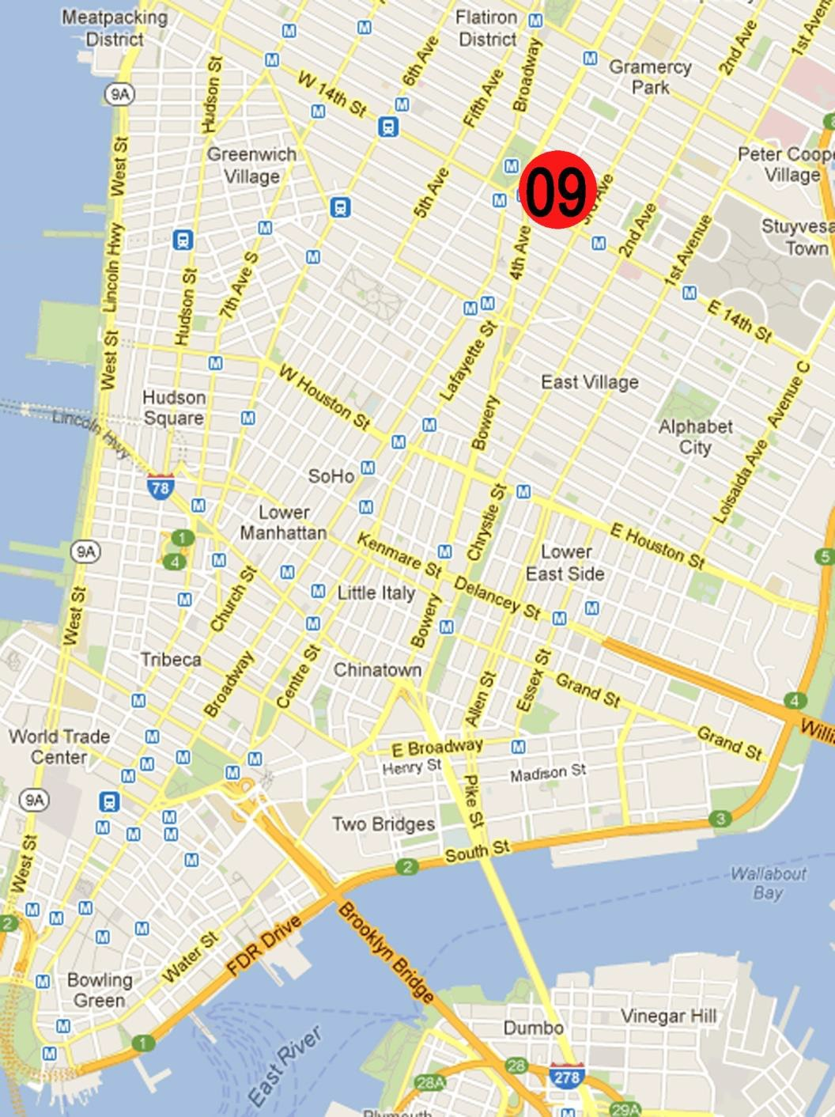
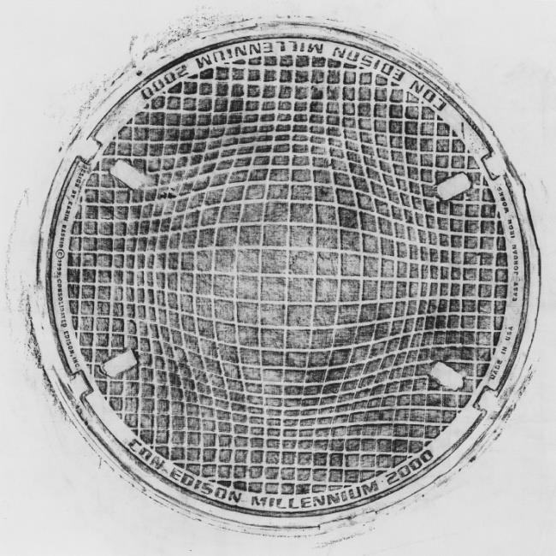
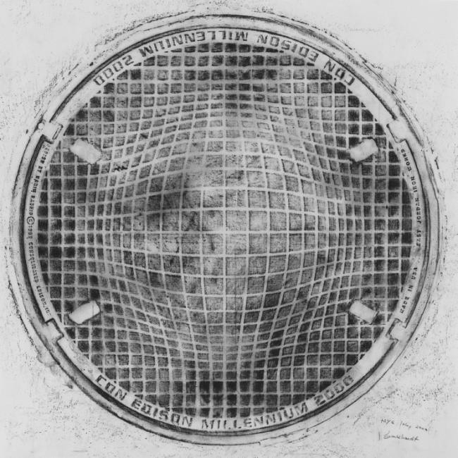
9
UNDERFOOT
IN NEW YORK
Gisla Burkhardt
Irving Place
1999 Karim Rashid; Millenium 2000
Rubbing July 2000
This fascinating cover was designed in 1999 by Karim Rashid from Egypt, a renowned architect, designer, all-round artist and as far as we know a participant of the famous »Documenta« in Kassel, Germany. He was the winner of the competition for the Millennium Cover contest initiated by Con Edison.
His cover named “Global Energy” designed for Con Edison for the turn of the millennium has an abstract globe-shaped pattern that seems to ripple. It is similar to the paintings of Vasarely (1908 – 1997), based on mathematical calculations. In my view, this manhole cover is excellent in its mutual completion both in formal graphical shape and its meaningful statement. And – this functional iron cast was made in New York – it is part of the millennium mania which included »Year 2000« bomber jackets, survivalist packages, and a cereal named »Millennium-Os« (NY Times, Sept. 1999).
This Millennium cover was graphically challenging: it has shifting three-dimensional effects. Therefore, I finished three rubbings in different techniques accentuating different effects. One displays the vault accented and another highlights the hole. In the third I didn’t highlight the spatiality of the design but played with shadows and light.
The mystifying effect caused by my graphical creations is an effect in the art style of the Op-Art of the 60ties.

Slide 10
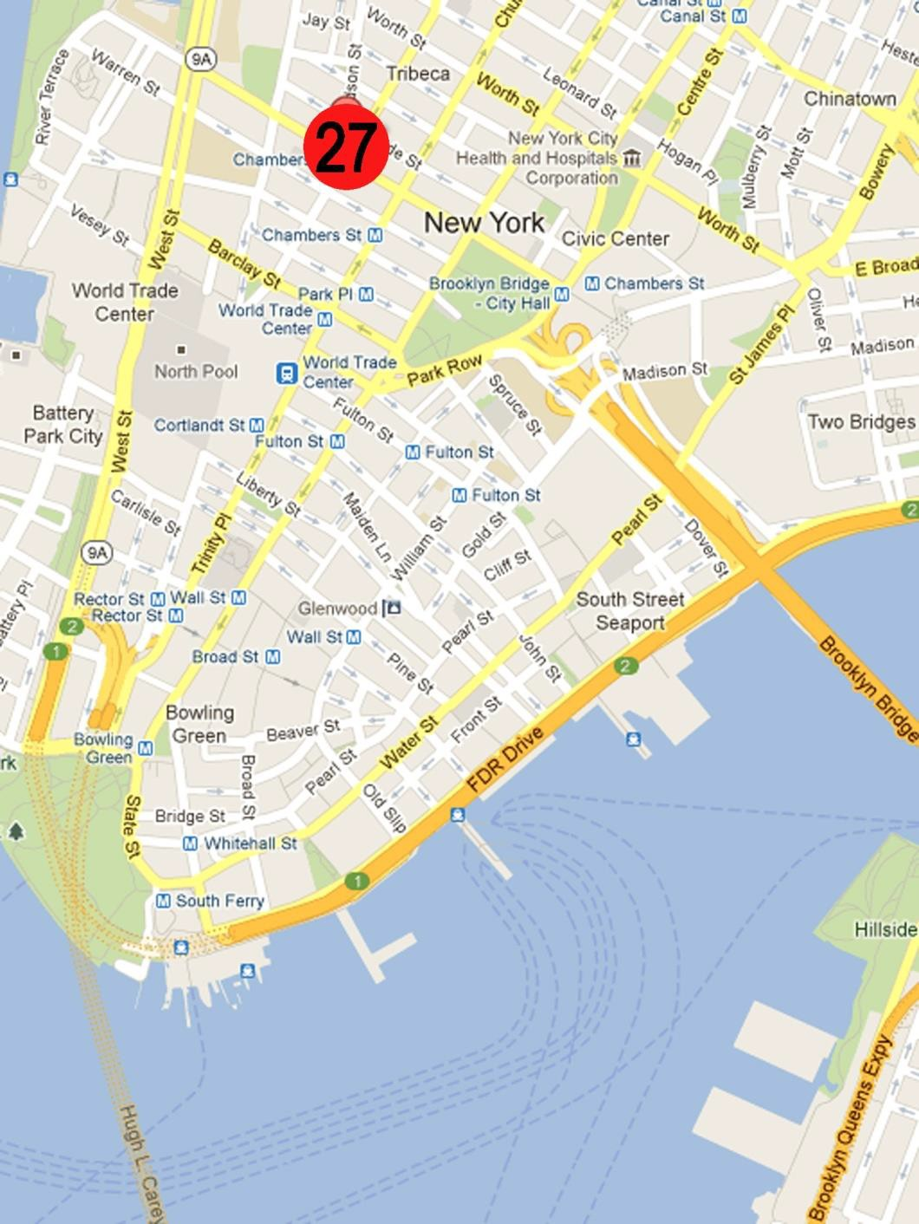
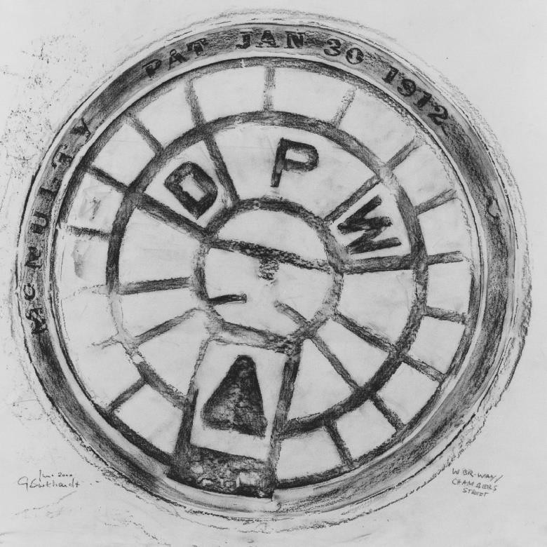
10
UNDERFOOT
IN NEW YORK
Gisla Burkhardt
West Broadway / Chambers Street
DPW – Department of Public Works; Mc Nulty Rubbing June 2000
There are many covers of the type »Department of Public Works« within the City, all of them in the form of a cartwheel, but with different inscriptions. This one has embossed spokes and rings, informing us about the foundry and the date of the patent: (McNulty, Jan. 30th, 1912). I liked inscriptions with such information due to the fact that I did not have to research it arduously in libraries as I had to with others.
This, I write despite the fact that visiting the fabulous library at the corner of 5th Ave. and 42nd St. was like participating in a celebration for me (especially on hot days when we had 90° F and more) due to the librarians friendly and quick service and the informative answers to my many questions.
I started early into my days in New York to be able to work undisturbed and not disturbing the purposeful flow of New Yorkers. I was walking the roads rather tired, nowhere meeting people »running for their lives« – with the sole exception of Chinatown – but finding plenty of people sleeping in doorways. On most days I had a nice and well-earned breakfast after completing two rubbings.
I went to one of those practical and homey coffee carts with steaming coffee and warm bagels mostly located next to a subway station where I meet crowds of people on their way to their workplaces. They were all gone by 07:30 a.m. – what a feast for early birds!

Slide 11
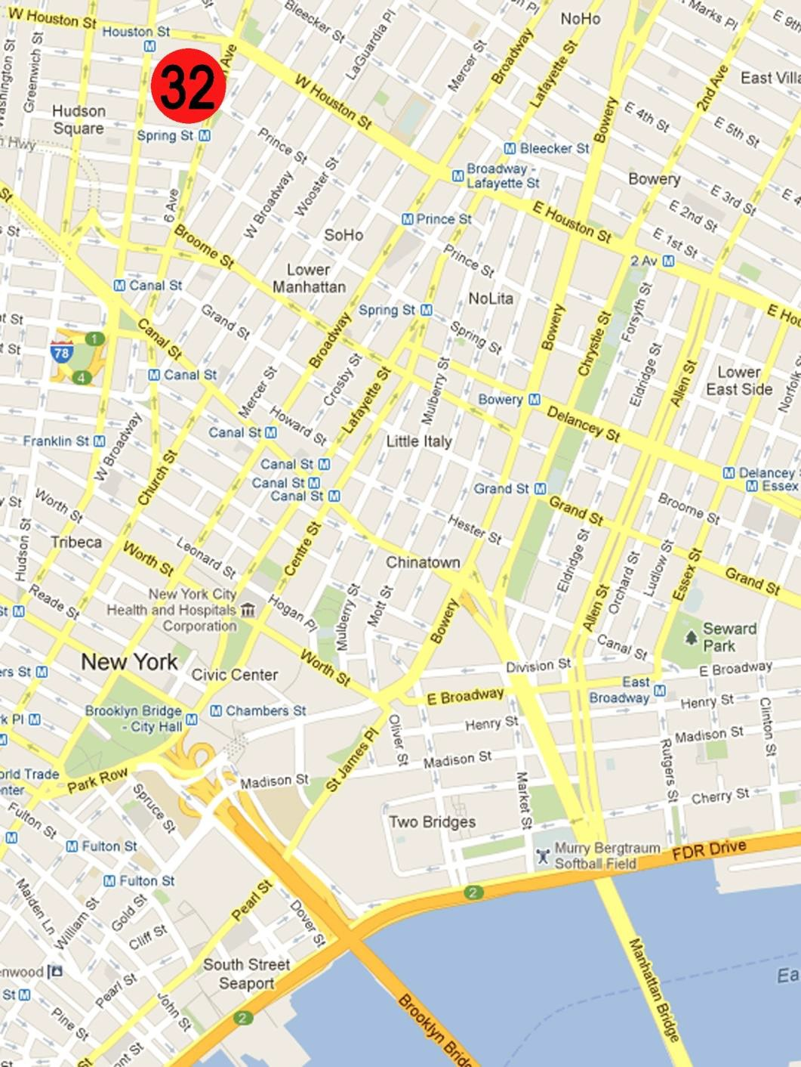
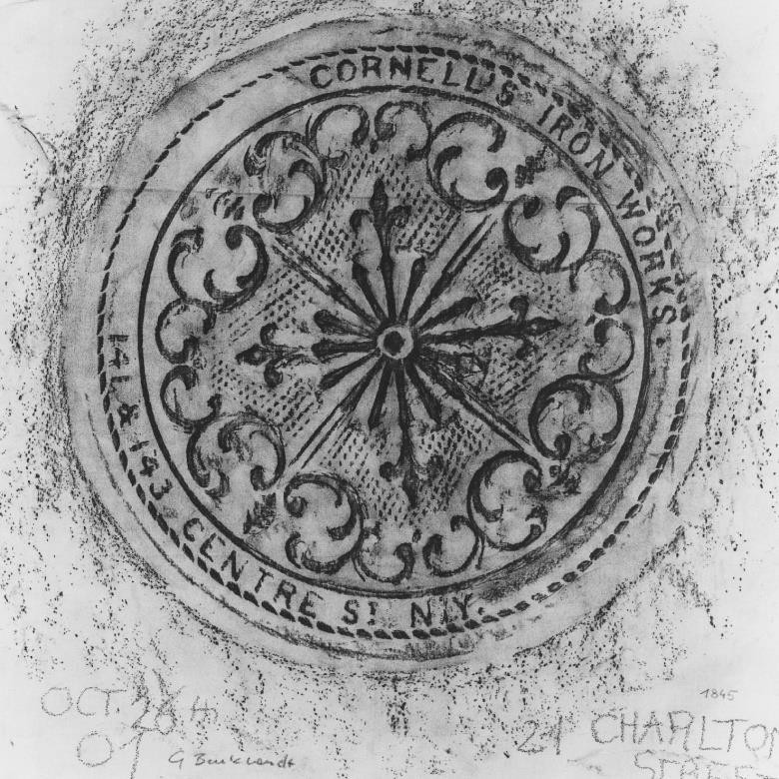
11
UNDERFOOT
IN NEW YORK
Gisla Burkhardt
21 Charlton Street
Cornell‘s Iron Works; 1845 Rubbing October 2001
As it happened, by pure chance I found another cover from Cornell’s foundry (see no. 01, Henry St.). This one displays a wonderful flower image pattern. I found it in a nice street with brownstone houses in SoHo quite close to one of the houses on the sidewalk. It displays the same address as the cover from no. 90, Henry St. in Brooklyn: 141 & 143 Centre Street. Cornell’s foundry was erected in 1840 close to Charlton Street and this coal chute cover most likely was one of the first ones installed in the neighbourhood.
Cornell produced a wide array of ironwork. The family-owned-company was one of the important foundries that established the Cast-Iron Historic District now known as SoHo and TriBeCa.
I made the rubbing in October 2001 – only one month after 9/11 – mostly I tried to work early in the morning: it was hard to work because of darkness, rain and wind! Like everybody on the street in those post-9/11 days, I had to wear a dust mask.
In The New York Chronicle Nr 3,1999, Diana Stuart wrote an article on »covers almost lost« and mentioned that “this beautiful coal chute cover [with an identical decor which] once adorned a Manhattan sidewalk is now part of the Cohill family’s patio” (a private collection of old manhole covers).

Slide 12
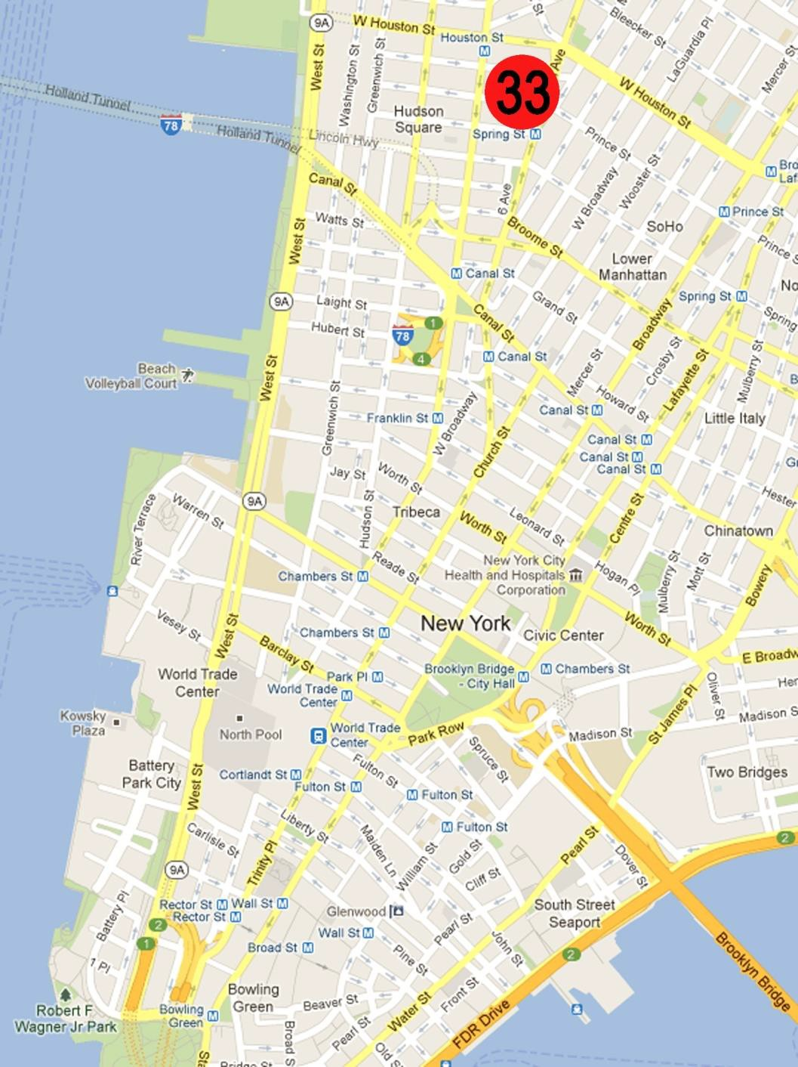
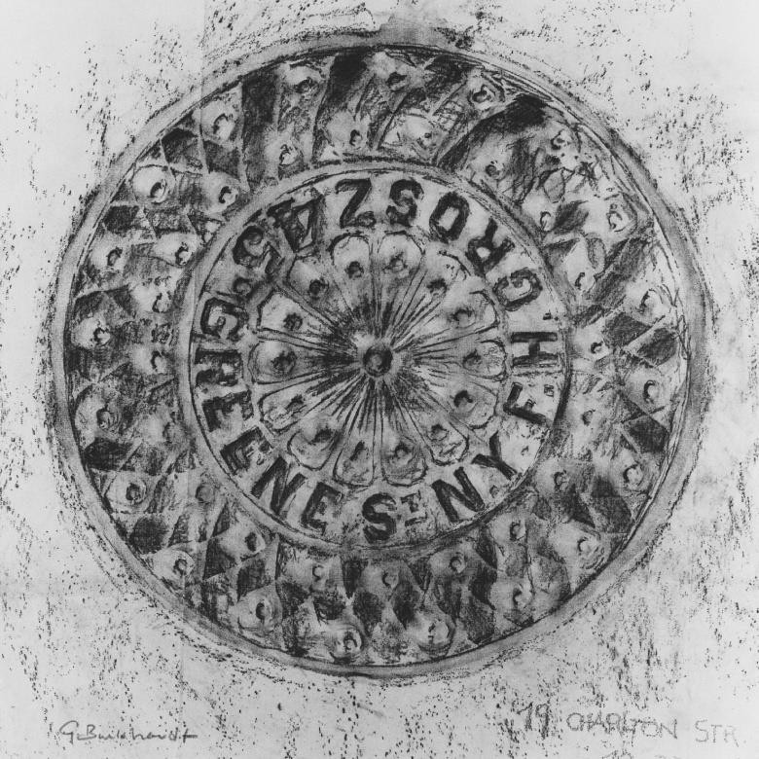
12
UNDERFOOT
IN NEW YORK
Gisla Burkhardt
19 Charlton Street
1845 N.Y.F.H. Grosz (foundry), coal chute-cover Rubbing October 2001
Next to the beautiful coal chute cover just described was another, very similar cover with a large flower in the middle and very decorative elements in concentric designed abstract ornaments. This one was made in 1845 by another famous foundry in the historic district of SoHo: N.Y.F.H. Grosz in 45 Greene Street.
Because it looked so private, I asked the house owner for permission to make a rubbing of his coal chute cover and we had a nice informative discussion about its former function: feeding the coal into the cellar underneath. He remembered as a child seeing the coal chute in action. He enjoyed learning about my project land liked my rubbing because he knew the value of this precious object and the possibility it could be stolen like other particularly old ones. He promised to keep an eye on it.
The year after, when I came back to look after my favorite covers, Nr. 19 Charlton Street was stolen. It was done in a »cloak-and-dagger operation«. No one had noticed it missing it seems. The chute now is closed with cement.
There are many collectors of iron covers and many thieves.

Slide 13
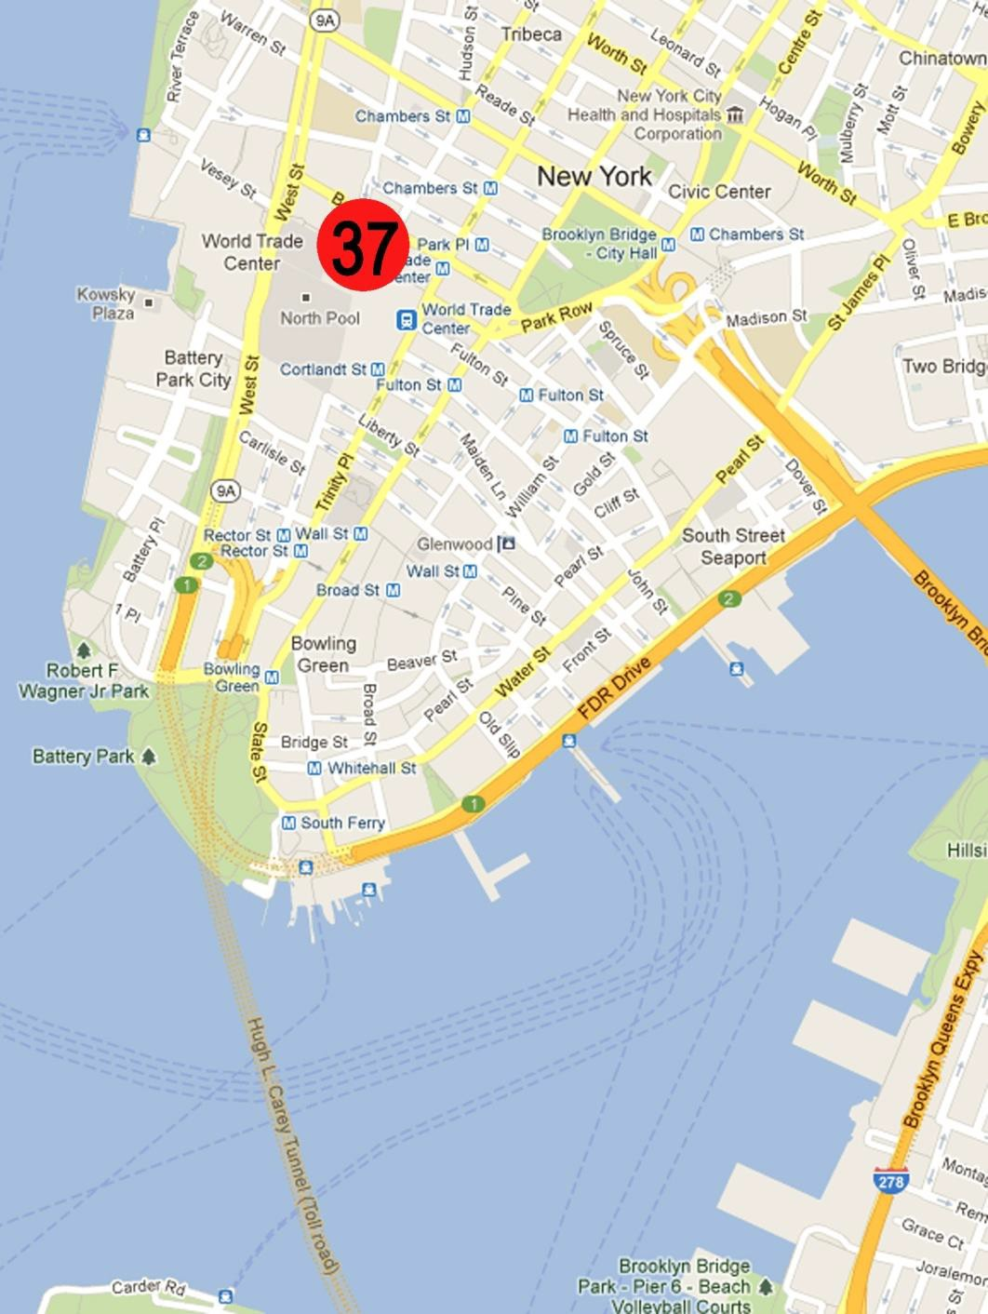
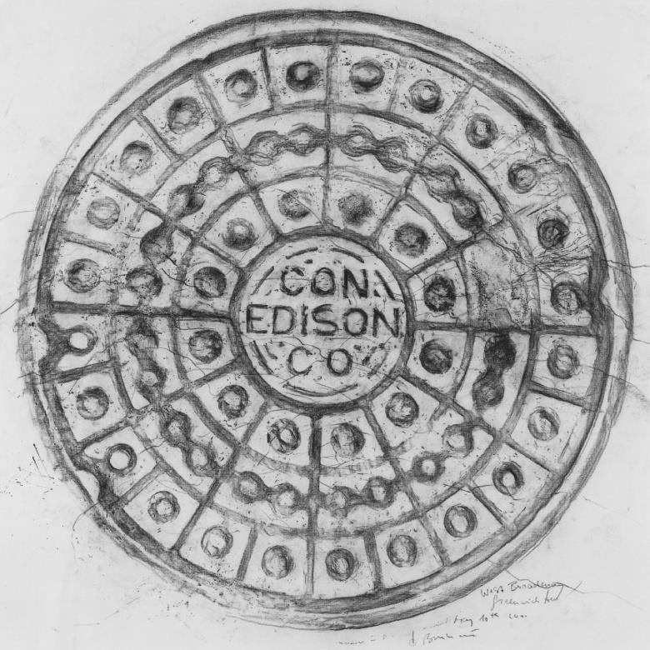
13
UNDERFOOT
IN NEW YORK
Gisla Burkhardt
West Broadway / Greenwich Street
Con Edison; 1929
Rubbing May 2000
Where I found this big manhole cover for Con Edison’s works, there were many casted lids with different utilities and functions underneath. – I remember this quite clearly!
I chose this one in the middle of the day when the area was overcrowded with busy people on the move. The next morning around 5 a.m. I made the rubbing undisturbed. Later I finished and overdrew the cotton in the studio with different hard graphite pens (bought at Pearl’s Paint on Canal Street).
It’s special design (from 1929) was used quite often by Con Edison: formed as a wheel with four round casted lines and spokes within this “circular bingo” or concentric circle design (Diana Stuart). It has three rows with casted embossed rings around holes, the ones in the middle row are bonded like chains. With its strong lines and the round dots, it looks so clear and bright.
This Con Edison cover for electric underground cables was the one closest to the North Tower of the former World Trade Center. I made the rubbing in May 2000. Now it is not there any more, replaced by the big construction site for the new One World Center.

Slide 14
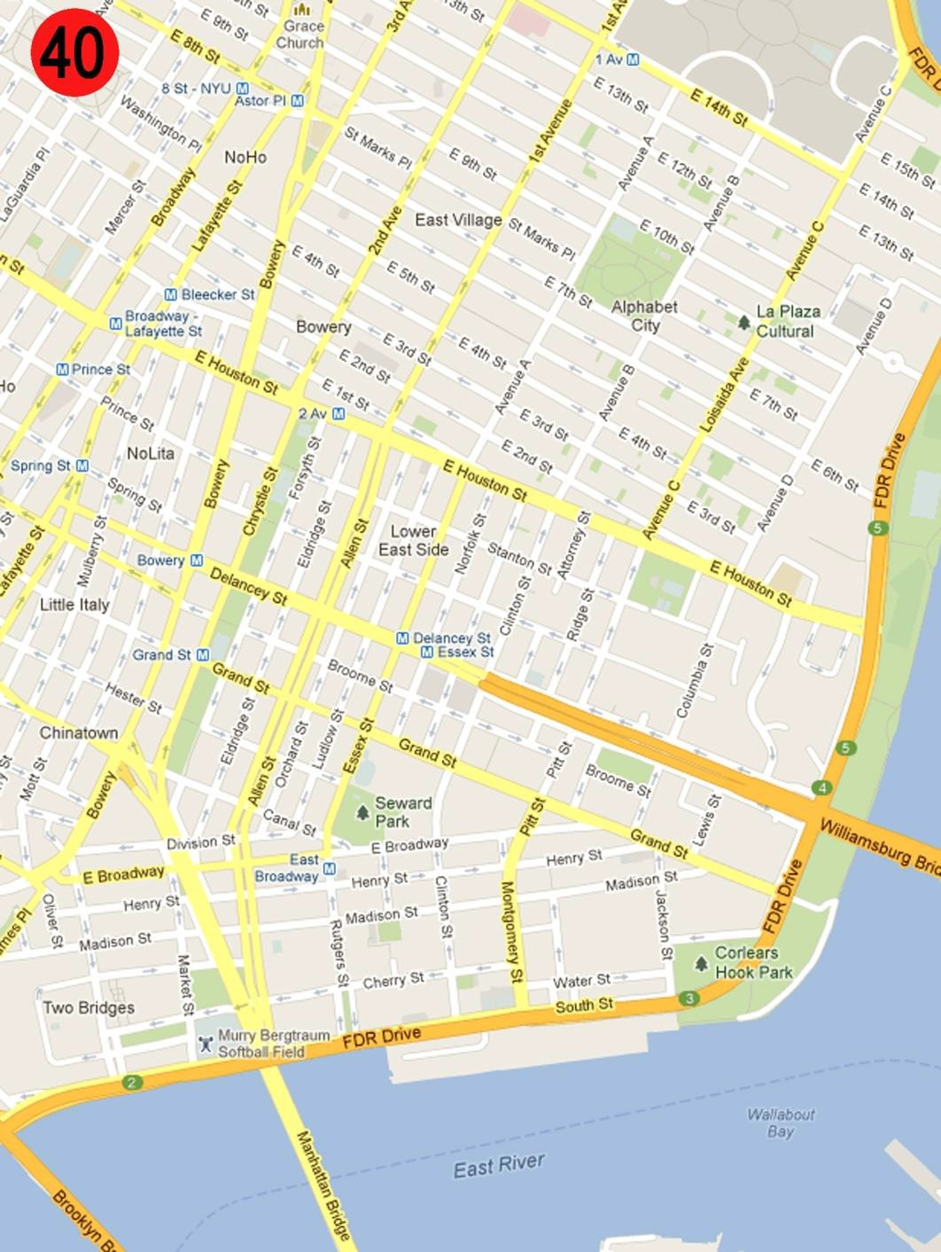
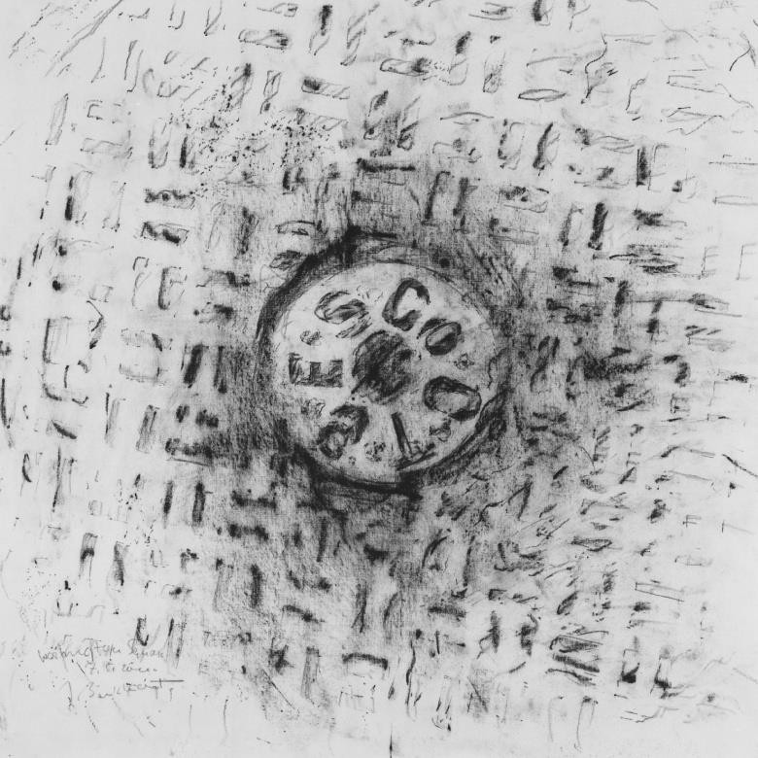
14
UNDERFOOT
IN NEW YORK
Gisla Burkhardt
Washington Square
C.T.E.S.Co – Consolidated Telegraph Electrical Subway Company, 1885 Rubbing May 2000
One of the places in NY I love most is Washington Square: in the afternoon it is crowded with students from the nearby university. Early in the morning when there were only a few people strolling with their dogs (nearly as many as in Berlin) I liked to do my rubbings at this well-kept place with its civilized aura.
The dog walkers were the inhabitants of the magnificent buildings surrounding the Park. They were interested and polite, asking about reason and purpose for the rubbings. Though one morning there was a young couple crying out “She is crazy, isn’t she?” This – irritating as it was – made me chuckle inside.
The C.T.E.S.Co cover dated 1885 is very large. This might be due to the fact that there are two utilities underneath: one for housing electricity and the other for subway cables. I did not include the frame of the cover in my rubbing. The ornaments were rather worn down: you could only partially guess its form.
But its wear and tear was the reason I liked it in particular. The cover shows the traces of the last 120 years. It was intriguing how this artefact displayed life’s perishability due to its exposure to time.

Slide 15
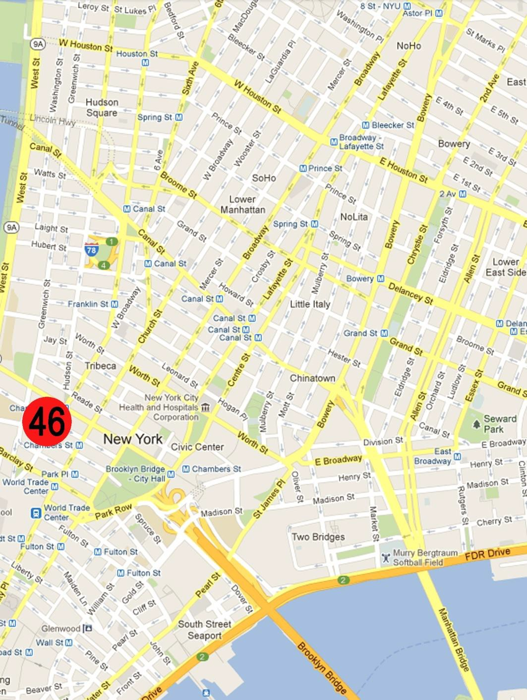
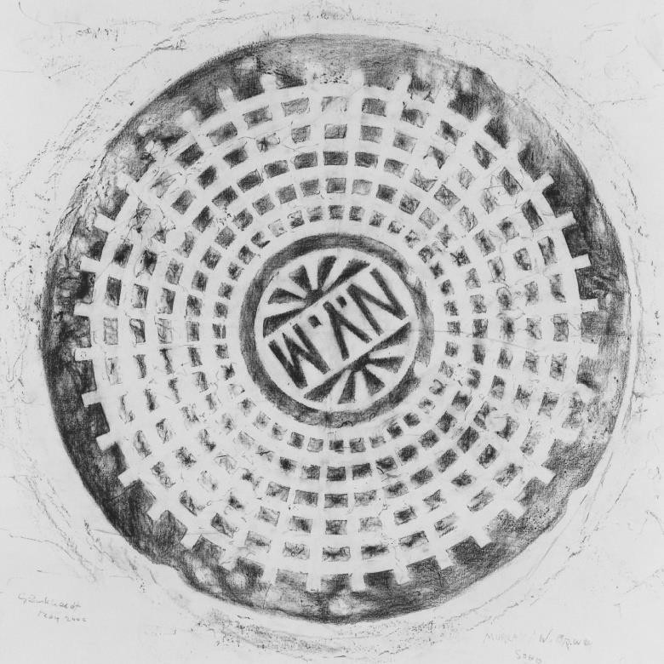
15
UNDERFOOT
IN NEW YORK
Gisla Burkhardt
Murray Street / West Broadway
N.Y.M. - New York Municipal (railway company) Rubbing May 2000
Covers with this design were installed on behalf of New York’s municipal railway approximately since 1913, which is most likely the time of its design and production.
New York Municipal Railway Corporation was founded in 1913 for the Brooklyn Rapid Transit, an Interborough Rapid Transit, part of today’s subway system.
The cover’s design displays six circular rings and radiant spokes. The letters within the inner circle, the areas in between the rings and the outer ring which looks like a gear-wheel , are embossed.
The intersection of Murray Street and West Broadway is full of manhole covers. This indicates that it is hollow throughout with canals and installations of diverse companies. Therefore, it was not really surprising when the road surface recently caved in when there was a rupture of a water main.

Slide 16
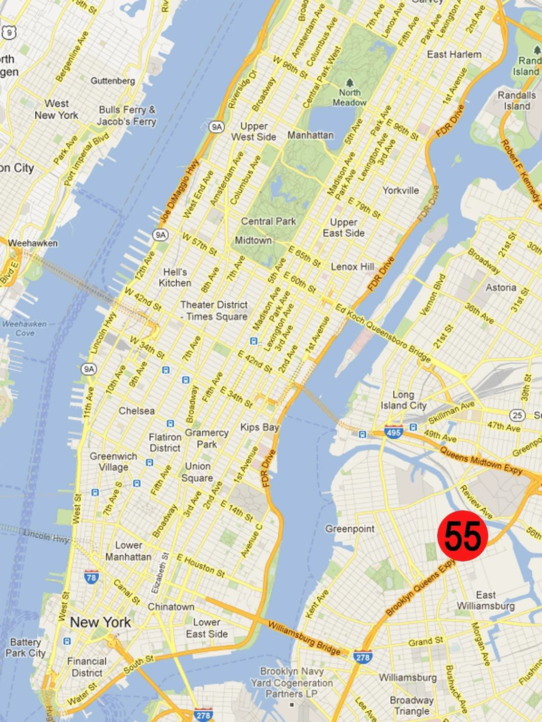
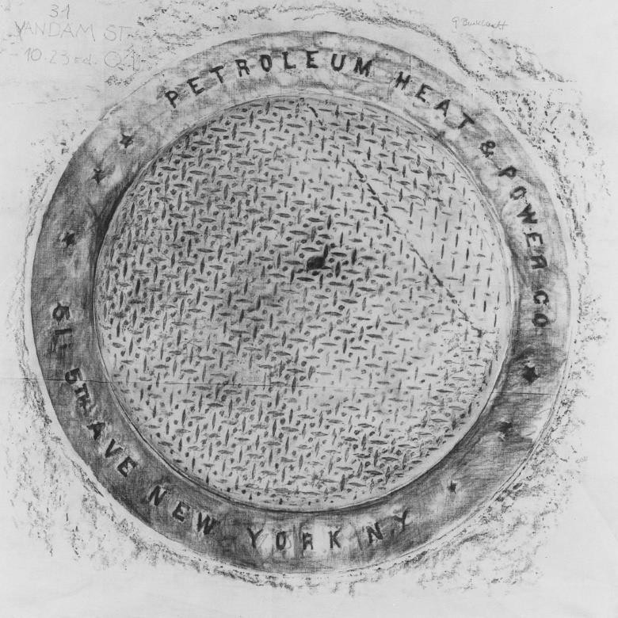
16
UNDERFOOT
IN NEW YORK
Gisla Burkhardt
31 Van Dam Street
Petroleum Heat and Power Co. Rubbing 23rd of Oct. 2001
Wow – was I happy, when I found this cover in 31 Van Dam Street! – It is large and it is inscribed with the utility underneath (»Petroleum Heat & Power CO«) and the street where the foundry was located (»5th Ave«). It must be very old because it dates from the time when people were still using petroleum-light. I thought it was a real discovery!
But – this was only my romantic imagination. In reality, it was the cover of a company founded in 1907 in San Francisco. Its presence in New York dates from 1920, when their offices were located at 511 on 5th Avenue. Today the Petroleum Heat & Power Company manufactures in Stamford, Connecticut, where they combine the merchandising of fuel oil with manufacturing oil installations.
Three stars separate the name and the company address like a frame, the whole middle is filled with little abstract fish. This cover might be one of the earliest examples with a rich fish-tread design. This mass-produced pattern is widely used today. Mostly for utilities / functions connected to air and light.

Slide 17
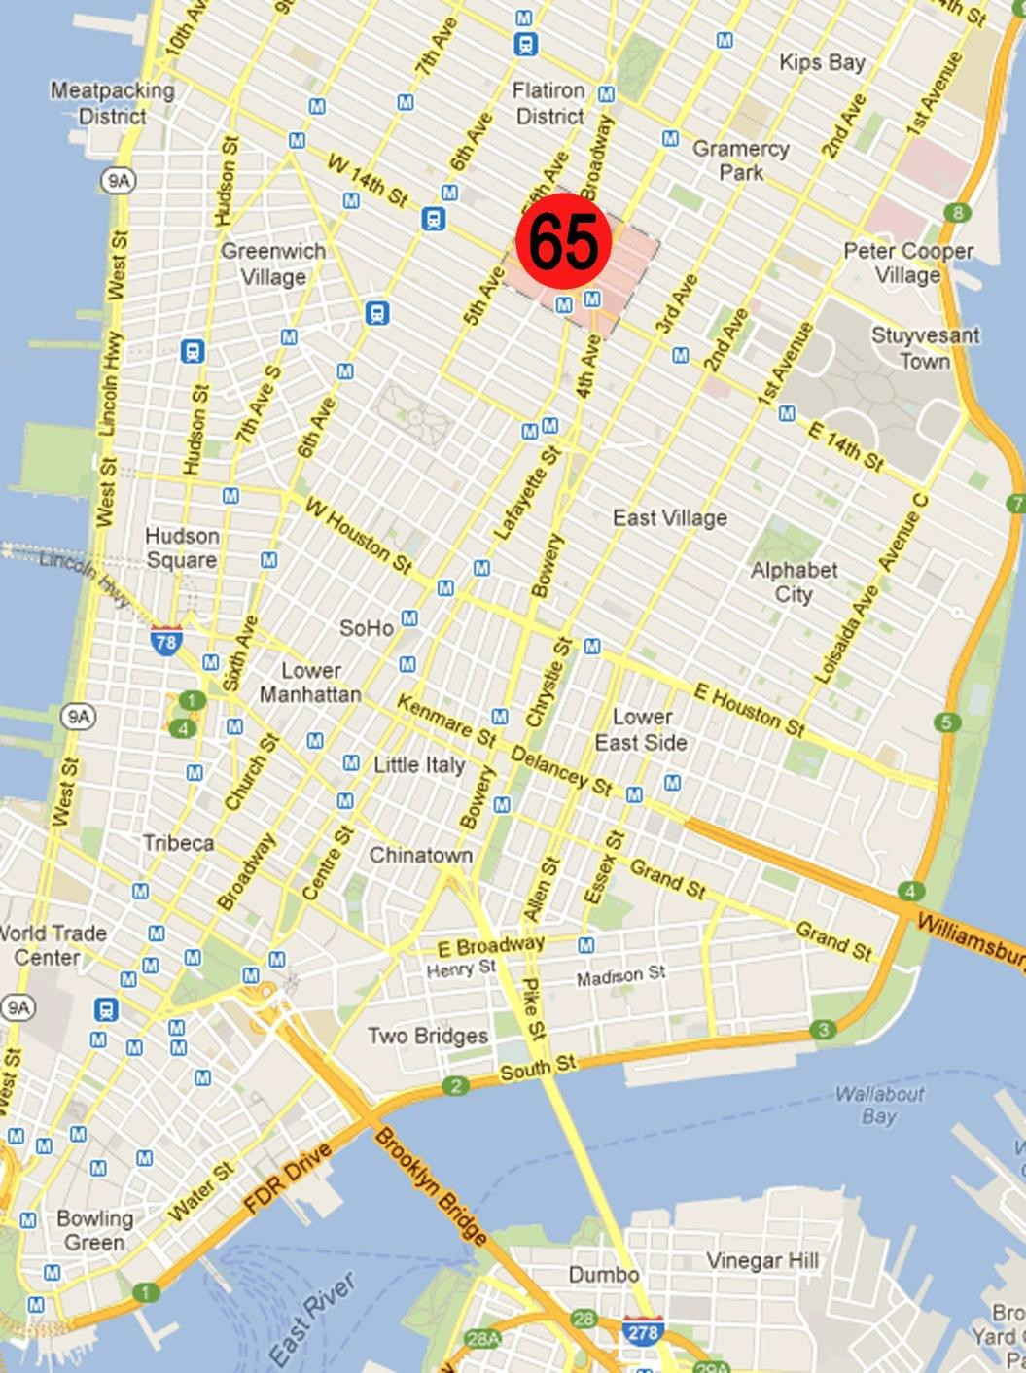
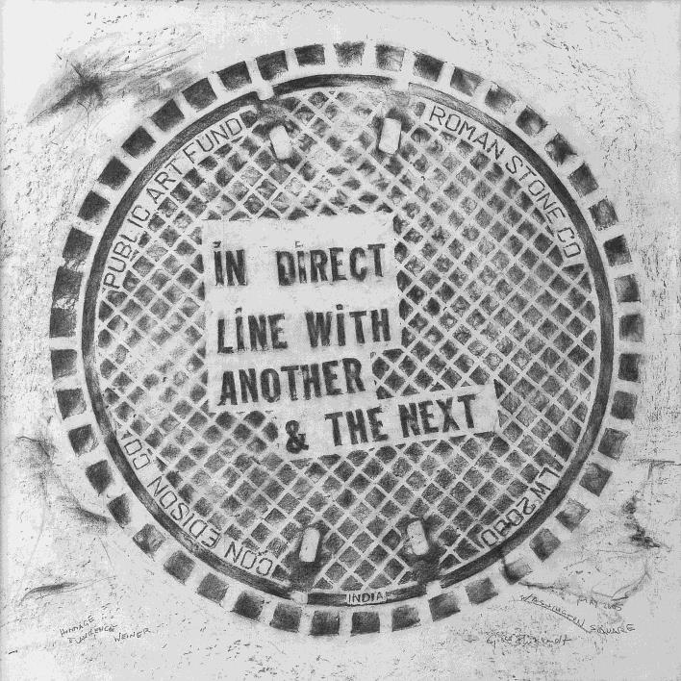
17
UNDERFOOT
IN NEW YORK
Gisla Burkhardt
Union Square
design by Lawrence Weiner, 2000 Rubbing May 2005
With the help of Con Edison and Roman Stone, a manhole cover fabricator in Bay Shore, Long Island, Lawrence Weiner, a New York conceptual artist, designed a new cover surface in his own special style. It was his answer to the Public Art Fund’s request to create his idea of the perfect New York City statement.
In summer 2005, I was pleased to be asked by Con Edison to prepare this rubbing for them. Now 19 covers were replicated and can be found across Manhattan from the West Village to Washington Square, Union Square and Tompkin Square Park. The manholes are intended to be temporary, but they may stay in place for some years, depending on Con Edison.
First I was irritated by the strange words in this noticeable graphic design against all composition-rules. The scripture looks like a montage of a different material. Lawrence Weiner explained his concept:
“It’s meant to be curious and evocative and poetic.... I wanted to use a normal part of the city to make people a little confused and a little curious.”
He also said that he chose these words because they refer to the grid of the city and the asphalt surface of the street.
This they do!

Slide 18
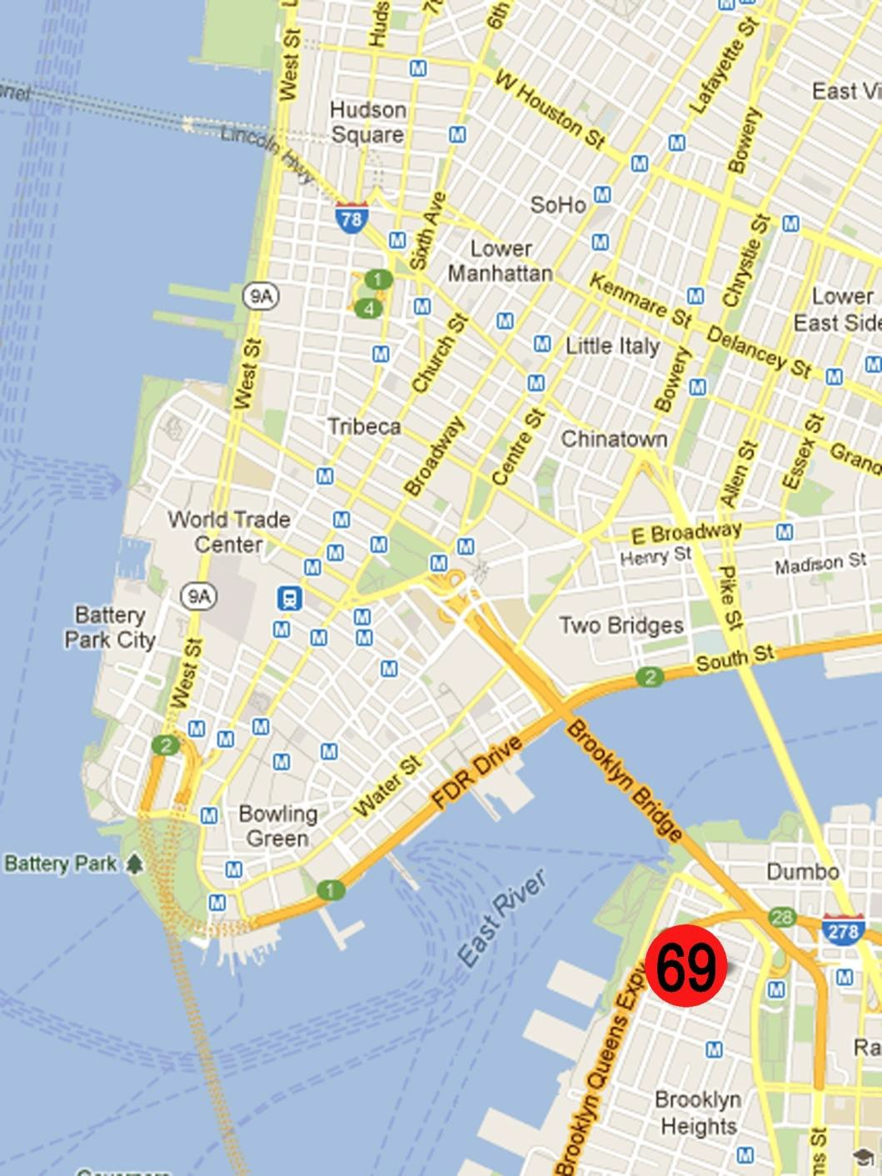
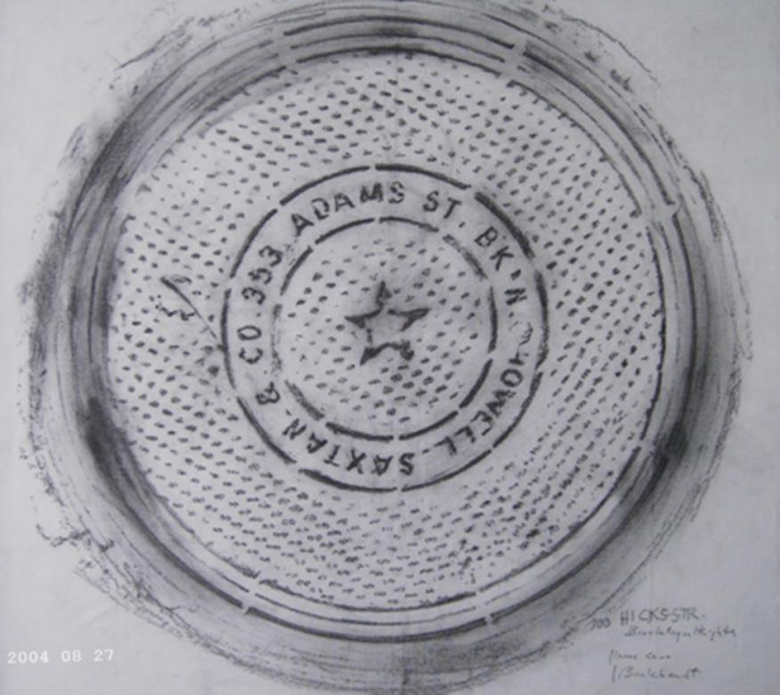
18
UNDERFOOT
IN NEW YORK
Gisla Burkhardt
36 Orange Street, Brooklyn Heights
Coal chute cover made by Howell Saxton & Co. Rubbing May 2000
This rubbing was done in my beloved Brooklyn Heights with its dark-red stone houses with iron balconies and iron fences and many trees. Many of those old buildings have coal chute covers from the old foundries like this one. Its inscription reads: »Howell Saxtan &. CO; 353 Adams St. BK’H«, written in a rimmed circle with a star in the middle. According to Diana Stuart »Howell« was the honourable James Howell, mayor of the City of Brooklyn for two terms beginning in 1877 and a trustee and later, president of what was called the »New York and Brooklyn Bridge«. Possibly he or one of his relatives was also one of the owners of a foundry. This cover was made in the last third of 19th century.
I remember a very interesting conversation with someone while I was rubbing in front of the house where he lived. He told me about a famous New York artist, “the doyenne of the New York avant-garde”, Sari Dienes (1898 – 1992), who worked on a similar project about 20 years earlier. But she used paper and later used the rubbings as a component for her media-mixed works. I became keen to hear about her friends. Sari lived together with John Cage and many other outstanding artists of that time in America and France. During my stay in New York I was lucky to see an exhibition of her art in a SoHo gallery.
In the end, the story of this corner is so sad: This cover was quarried out of the sidewalk and the hole filled with concrete.

Slide 19
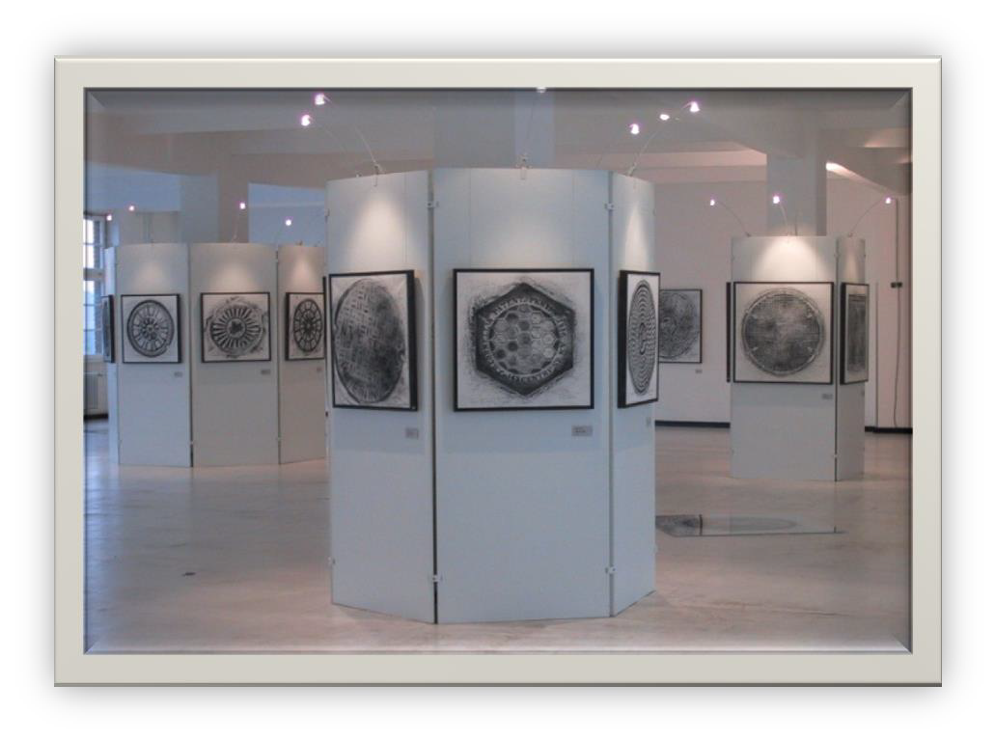
19
UNDERFOOT
IN NEW YORK
INSPIRATION
by IE &
Gisla Burkhardt
Inspiration Underfoot in New York:
A Project for People in Transition – Young and Old
Probably nearly every child sooner or later playfully will make a rubbing of a coin or other object. Gisla Burkhardt‘s rubbings UNDERFOOT IN NEW YORK and her project INSPIRATION UNDERFOOT IN NEW YORK connect to our childhood rubbings and adventures. The project opens a whole world of inspiration and creativity from art and culture often stepped upon. We are educated in our heritage while opening our eyes to the beauty around us. The project is grounded in the City‘s urban development and in art – art that exists in everyday life; art that in its core is there for everybody!
Gisla‘s project INSPIRATION UNDERFOOT IN NEW YORK will open the hearts and minds of people in transition to see the unexpected and find inspiration where none was before. It will bring together young and old people from around the world and tells the story of a city with its vast history and diverse culture. It‘s the story of transition!
Preview of a sample of UNDERFOOT IN NEW YORK displayed in Berlin at GSG in December 2001 in cooperation with International Design Center
INSPIRATION UNDERFOOT IN NEW YORK is a project for people in transition – having reached midlife and asking themselves where they come from and what they still aim to achieve. It is changing their perspectives – from looking up to looking down and seeing possibilities and beauty in places least expected.
The project is developed by IE, the INSPIRING ENVIRONMENT initiative, an association based in Berlin reaching out to New York and to people in transition worldwide to heighten awareness and belief in possibilities, creativity, growth and meaning hidden in the for- gotten relics of the past as we move through the many changes in life.

Slide 20

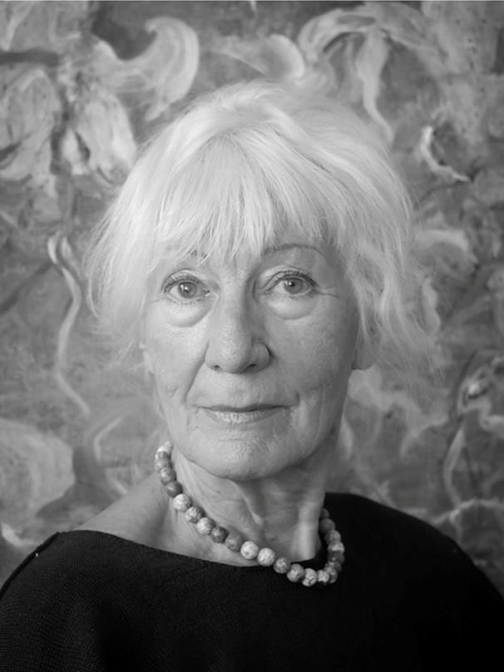
Gisla Burkhardt
20
Vita
Gisla Burkhardt was born in Emmerich, Germany in the lower Rhine region in 1938. She was a renowned artist. Her early studies at »Staatliche Kunstakademie in Stuttgart« and at »Hochschule für Bildende Künste« in Berlin motivated her to create from her heart incorporating old techniques in new ways.
She has been living in Berlin since 1961. Since 1965 she has had numerous expositions with art associations, galleries, museums and other institutions. From 1972 to 1982 she was an art teacher in Berlin. She was honoured to have been a member of the evaluation committee of »Künstlerförderung Berlin«, a Berlin city-state organization supporting young artists including artists like the now renowned artist Georg Baselitz in his youth. Like Lawrence Weiner (see above pg. 17 – cover no. 65, Union Square) and Karim Rashid (see above pg. 9 – cover no. 9, Irving Place), she participated in Documenta numerous times.
Since 1999, she travelled annually to New York, working there for several months during each trip on her projekt UNDERFOOT IN NEW YORK.
Gisla Burkhardt died in Berlin on July 4, 2024.

Slide 21
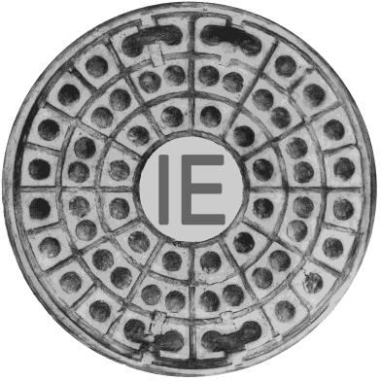
INSPIRATION
21
UNDERFOOT
IN NEW YORK
by IE &
Gisla Burkhardt
http://gisla-art.github.io
Literature
Diana Stuart: Designs Underfoot. The Art of Manhole Covers in New York City 2003 Published by Design Books
Mimi & Robert A.
Melnick:
Manhole Covers. 1994 Massachusetts Institute of Technology, Second printing.
New York Times: various articles between 2000 and 2005
New York Chronicle
Con Edison Millennium 2000 by Karim Rashid, Irving Place Rubbing made July 2000
IE, the INSPIRING ENVIRONMENT
initiative, an association based in Berlin reaching out to New York and to people in transition worldwide

